Slide 1
Bike Shop Analysis
Suzan Yemane
04/12/2024

Slide 2
Business requirements and Tasks
Requirements:
Hourly Revenue Analysis
Profit and Revenue Trend
Seasonal Revenue
Rider Demographic
Design and Aesthetics: use company colors and ensure the dashboard easy to navigate.
Tasks
Create Database
Develop SQL queries
Connect Power BI to DB
Build a Dashboard in Power BI
Answer the analysis questions

Slide 3
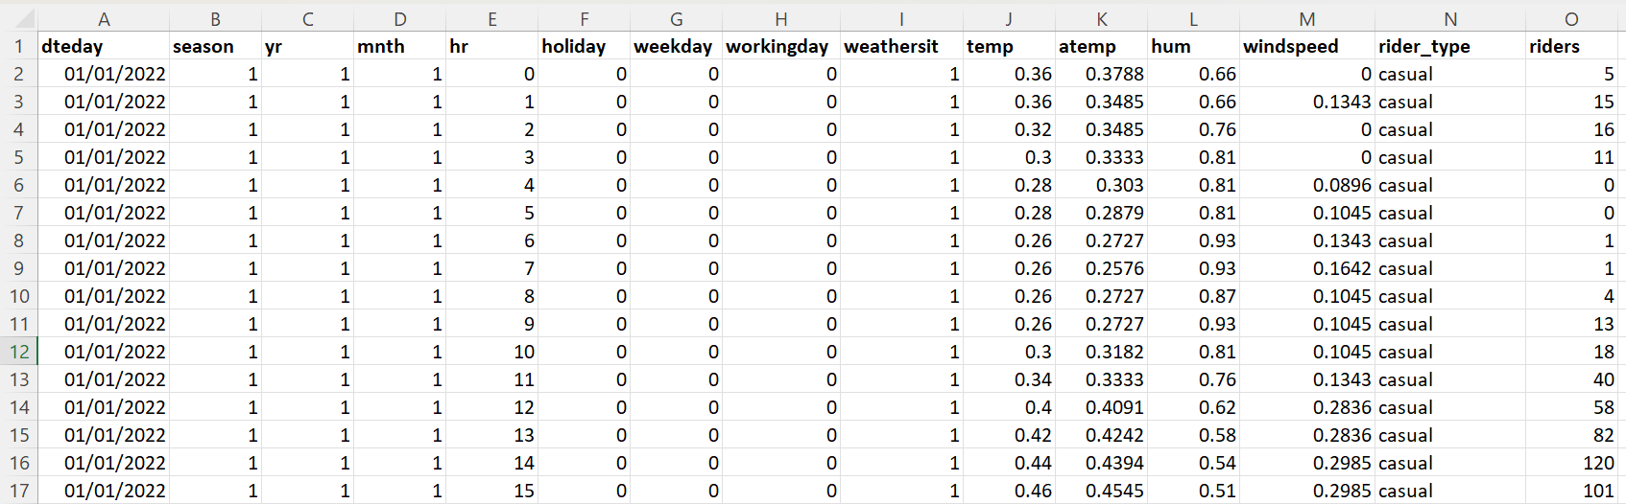
Table view

Slide 4
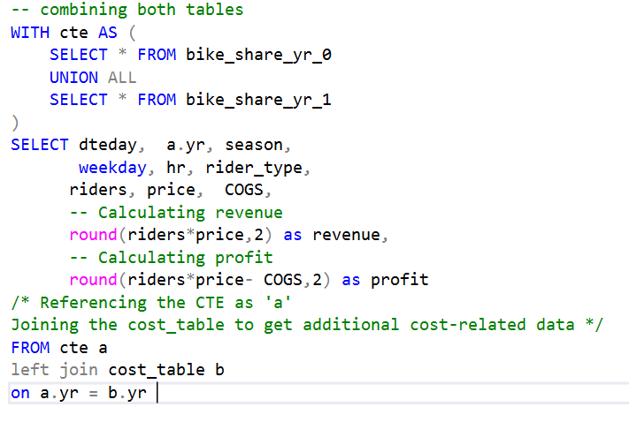

Creating Database
Tables
bike_riders_2021
Bike_riders_2022
Cost_table

Slide 5
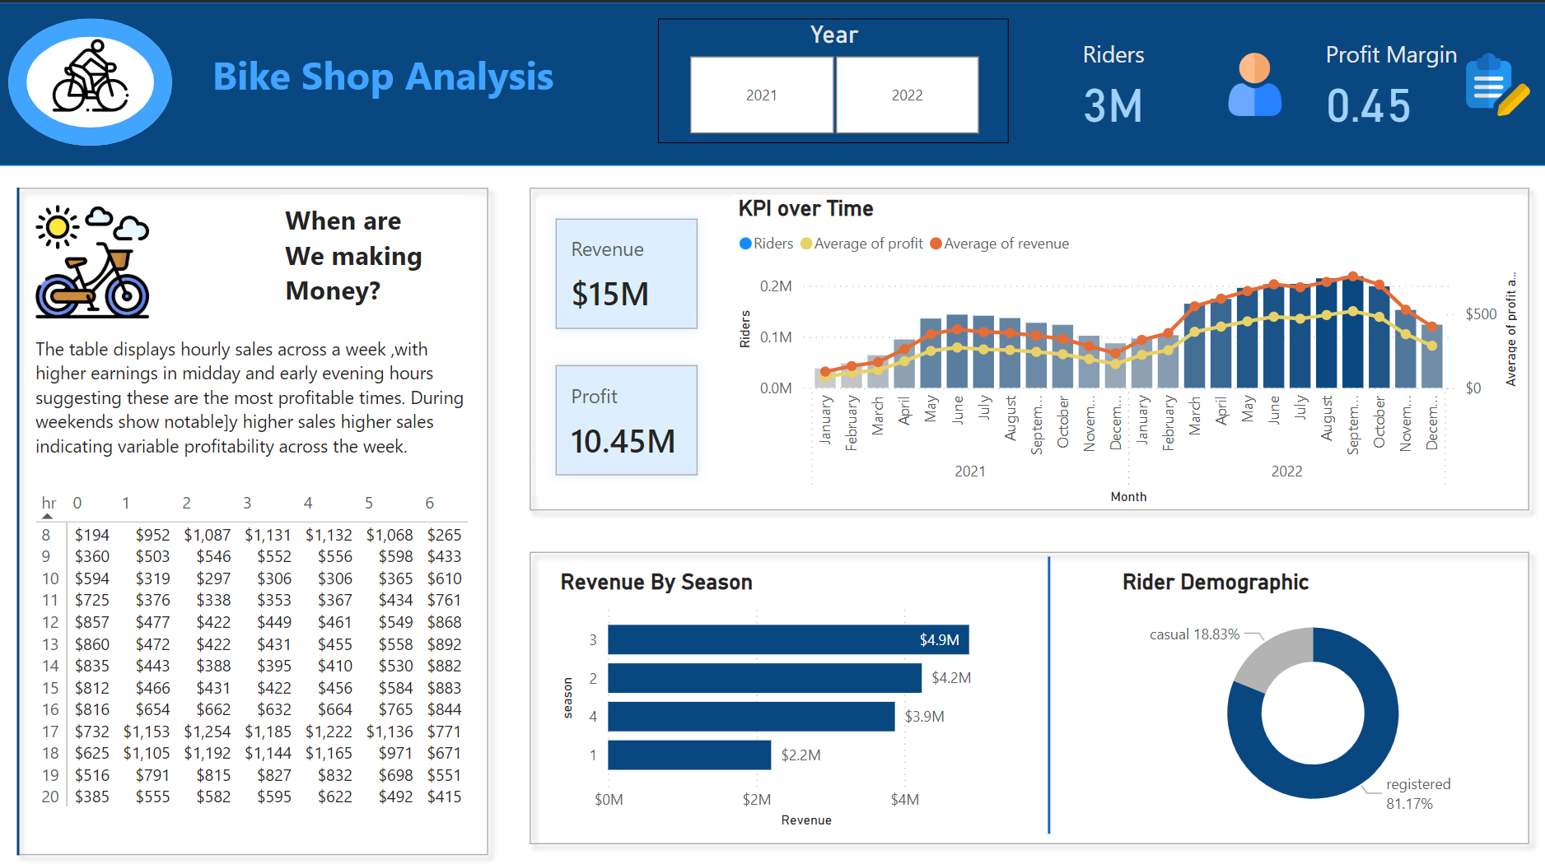
Dashboard

Slide 6


Thank you!
LinkedIn
Github

